Slide 1
chat GPT

Slide 2

2015
Chat GPT-1 – 2018
Chat GPT-2 – 2019
Chat GPT-3 – 2020
Chat GPT3X – 2022

Slide 3
chat GPT
Generative Pre-trained Transformer
In a nutshell, Chat GPT is an
artificial intelligence (AI) content generator
that semi-autonomously creates phrases and articles
based on user input.

Slide 4
key aspects of human intelligence:
Cognitive abilities: Thinking, reasoning, problem-solving, and memory.
Learning and adaptability: Acquiring knowledge and applying it to different situations.
Abstract thinking: Grasping complex ideas and making connections.
Communication: Effective use of language for understanding and expression.
Social and emotional understanding: Interacting with others and managing emotions.
Problem solving and adaptability: Finding solutions and adjusting to new situations.

Slide 5
chat GPT
Generative Pre-trained Transformer
In a nutshell, Chat GPT is an
artificial intelligence (AI) content generator
that semi-autonomously creates phrases and articles
based on user input.

Slide 6
"Autonomously" refers to the ability of a system or entity to act, function, or make decisions independently, without external control or influence. It implies self-governance or self-direction. Car
“Automatically" refers to a process or action that occurs without manual intervention or human effort. It implies the use of mechanisms, sensors, or predefined rules to perform tasks or execute actions. automatic washing machine

Slide 7
chat GPT
Fine-tuning:- One of the most common ways to use Chat GPT is to fine-tune the model on a specific task or dataset. For example, you can fine-tune the model on a dataset of customer service conversations to improve its ability to understand and respond to customer inquiries.
Text generation:- Chat GPT can be used to generate text on a variety of topics. This can be done by providing the model with a prompt or a piece of text and asking it to generate additional text based on that input. This can be useful for content creation, for example, you can use it for writing articles, or even writing code.
Question answering:- Chat GPT can be fine-tuned to answer questions based on a given context or knowledge base. This can be useful for building chatbots or information retrieval systems.
Text summarization:- Another use case of Chat GPT is text summarization, where the model is fine-tuned to generate a summary of a longer piece of text.
Language Translation:- Another use case of Chat GPT is language translation, where the model can be fine-tuned for machine translation tasks.
Multimodal Learning:- Chat GPT can also be fine-tuned to understand and generate text in relation to images, audio, and video. This is known as multimodal learning, and it enables Chat GPT to understand and generate a more diverse range of content.

Slide 8
chat GPT
Generative Pre-trained Transformer
In a nutshell, Chat GPT is an
artificial intelligence (AI) content generator
that semi-autonomously creates phrases and articles
based on user input.

Slide 9
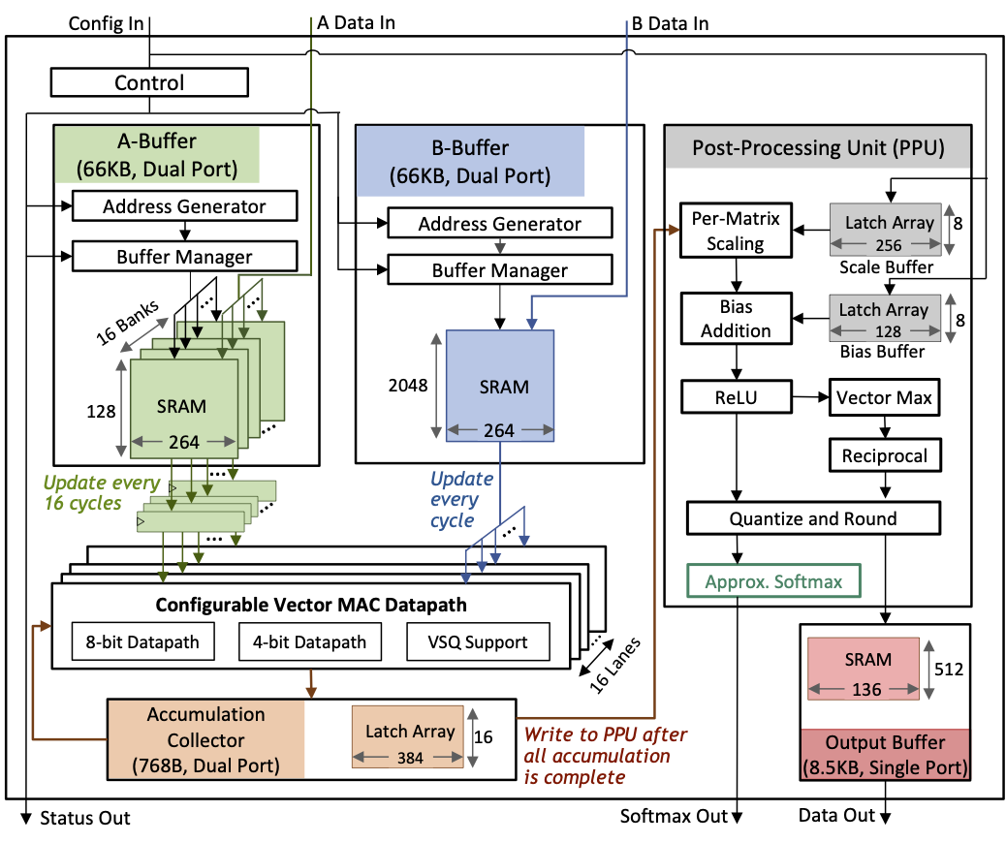
Transformer
a specific type of
deep learning model architecture
called the Transformer model.

Slide 10
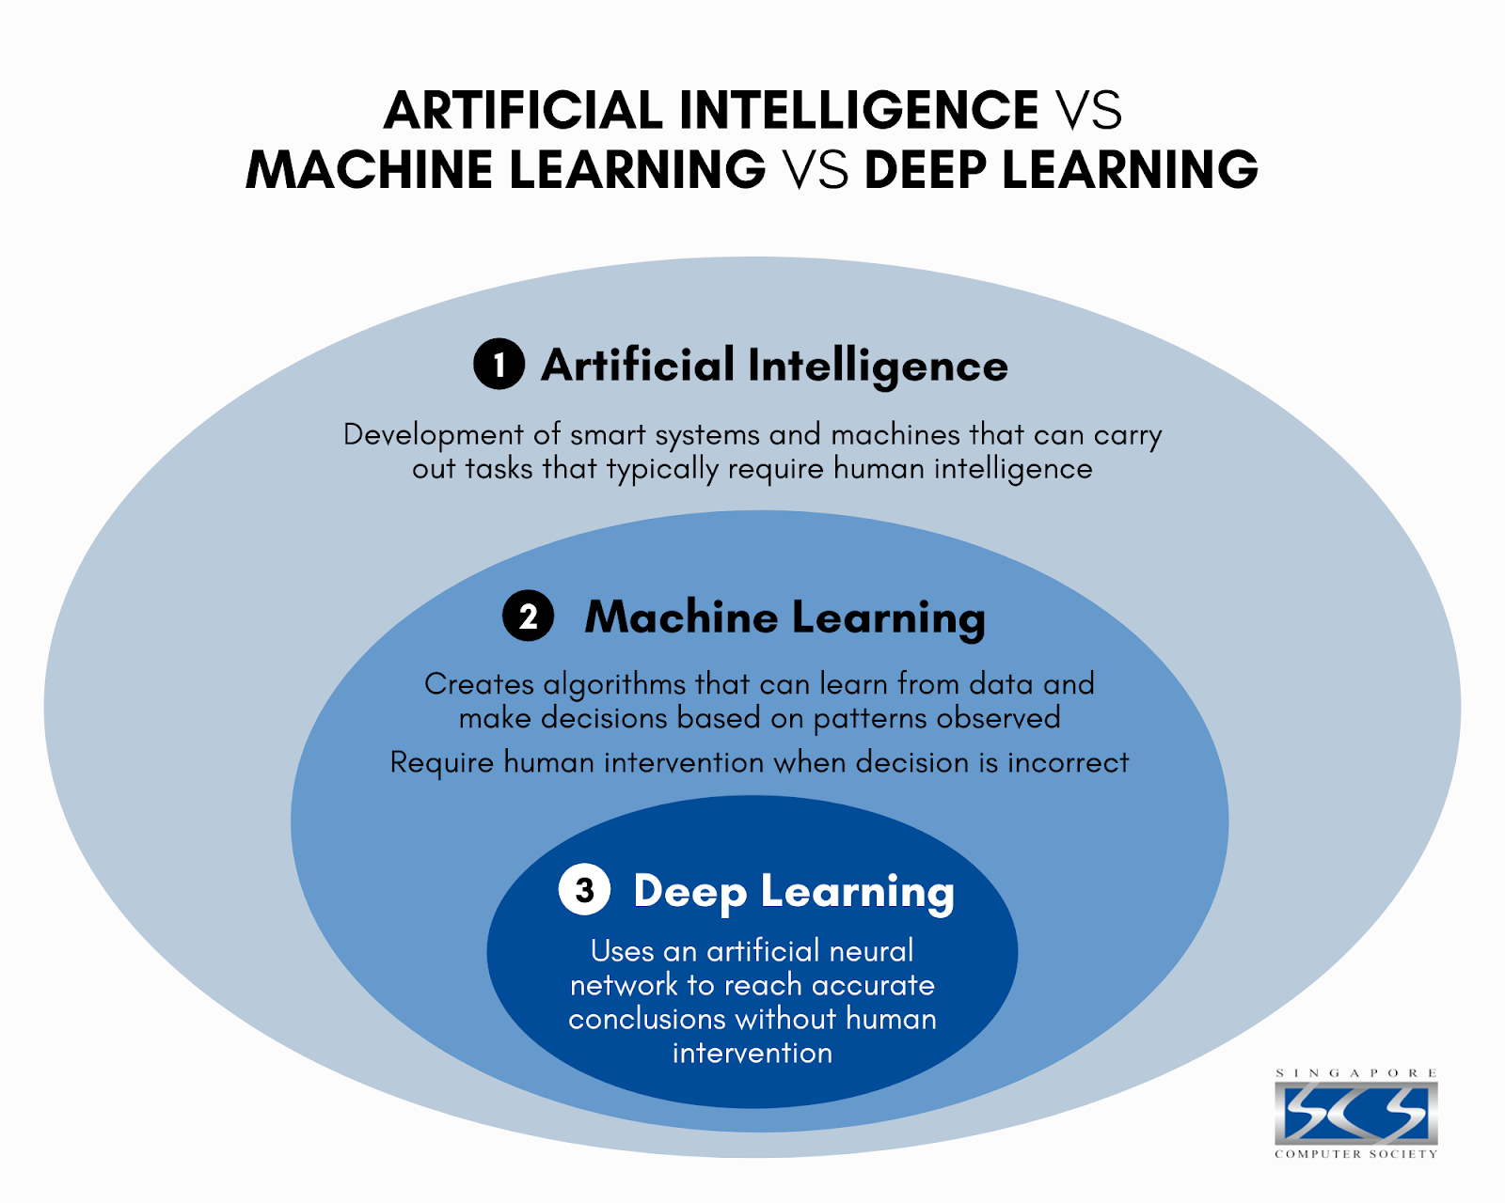

Slide 11


Slide 12
Alan Turing
The brand name was inspired by Eve’s bite out of the apple.
The story of Nymphus gaining immortality by eating a golden apple.
Alan Turing,
the father of modern computing,
died after eating a poisoned apple.
From the famous saying: “an apple a day keeps the doctor away.”
Some claim that the three founders wanted a more casual name.
Steve Jobs and Steve Wozniak wanted the Apple brand name to appear before Atari in phone books.
출처: <https://www.crowdspring.com/blog/apple-logo/>

Slide 13
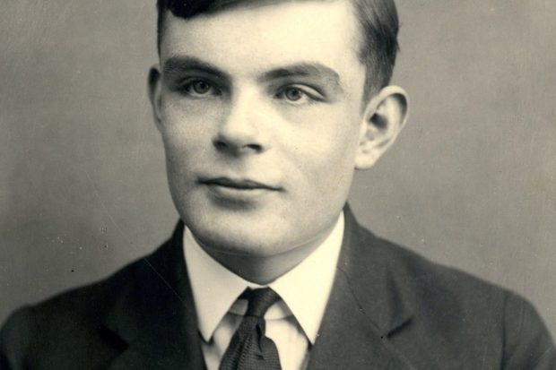
Alan Mathison Turing
1912 –1954
British mathematician,
computer scientist,
logician,
cryptanalyst,
philosopher,
theoretical biologist.

Slide 14


Slide 15
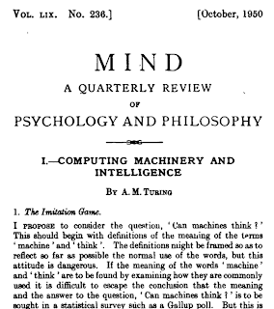
Computing machinery and intelligence
Alan M. TuringMind 59 (October):433-60 (1950) Abstract
I propose to consider the question,"Can machines think?"
Title: Mind
Publication Year: Established in 1876 (continuing to the present)
Publisher: Oxford University Press
Focus: Philosophy of mind, cognitive science, and related disciplines
Scope: Mind publishes articles and discussions on various topics within philosophy of mind, including consciousness, perception, cognition, philosophy of language, philosophy of psychology, and philosophy of artificial intelligence.
출처: <https://philpapers.org/rec/TURCMA>

Slide 16
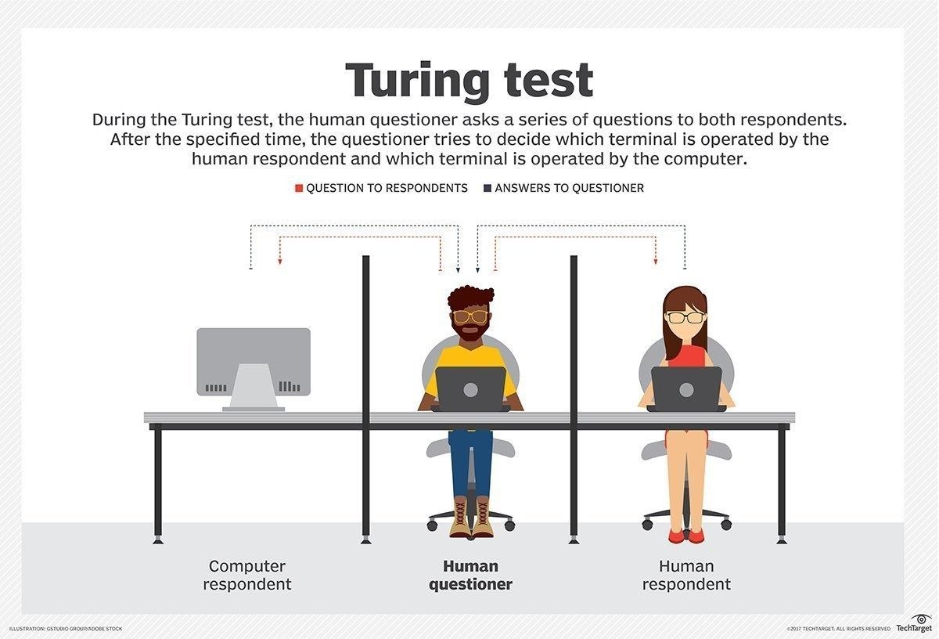

Slide 17
AI history by chat GPT
Dartmouth Conference (1956): The term "artificial intelligence" was coined, and the field of AI was officially established during this conference.
General Problem Solver (GPS) (1957): Also created by Newell and Simon, GPS was a more advanced problem-solving program that could solve a wider range of problems.
ELIZA (1966): Developed by Joseph Weizenbaum, ELIZA was a computer program designed to simulate human conversation, laying the foundation for natural language processing.
Shakey the Robot (1966): Shakey, developed at Stanford Research Institute, was one of the first mobile robots capable of perceiving its environment and performing tasks autonomously.
Expert Systems (1970s): The development of expert systems, such as MYCIN for medical diagnosis, marked a significant advancement in AI, focusing on capturing and using human expertise in specific domains.
Backpropagation Algorithm (1986): The backpropagation algorithm, developed by Geoffrey Hinton, revolutionized neural network training and contributed to the resurgence of AI research.
Deep Blue vs. Garry Kasparov (1997): IBM's Deep Blue defeated world chess champion Garry Kasparov, showcasing the potential of AI in complex strategic games.
IBM Watson (2011): Watson, an AI system developed by IBM, won the game show Jeopardy! by demonstrating natural language processing and knowledge representation capabilities.
AlphaGo vs. Lee Sedol (2016) DeepMind's AlphaGo defeated world Go champion Lee Sedol, demonstrating AI's ability to master complex board games through reinforcement learning.
OpenAI's GPT-3 (2020) GPT-3, developed by OpenAI, is a state-of-the-art language model that showcases the advancements in natural language processing and generation.
출처: <https://chat.openai.com/>

Slide 18
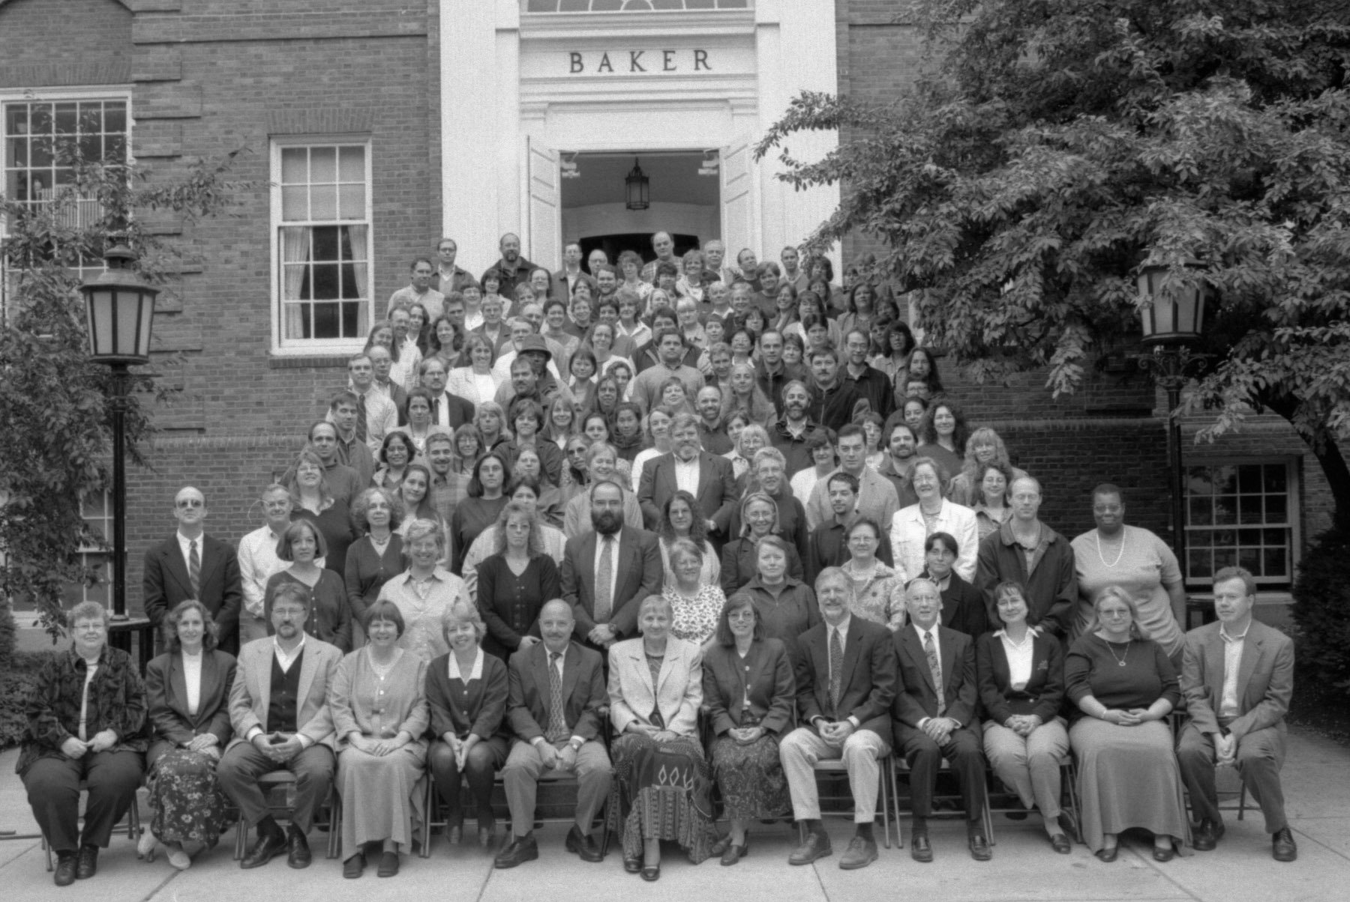
Dartmouth Conference 1956
This week in The History of AI at AIWS.net – the Dartmouth Conference began on 18 June 1956. This gathering would run through the entire summer at Dartmouth College in Hanover, New Hampshire.

Slide 19

AlphaGo vs. Lee Sedol (2016)

Slide 20
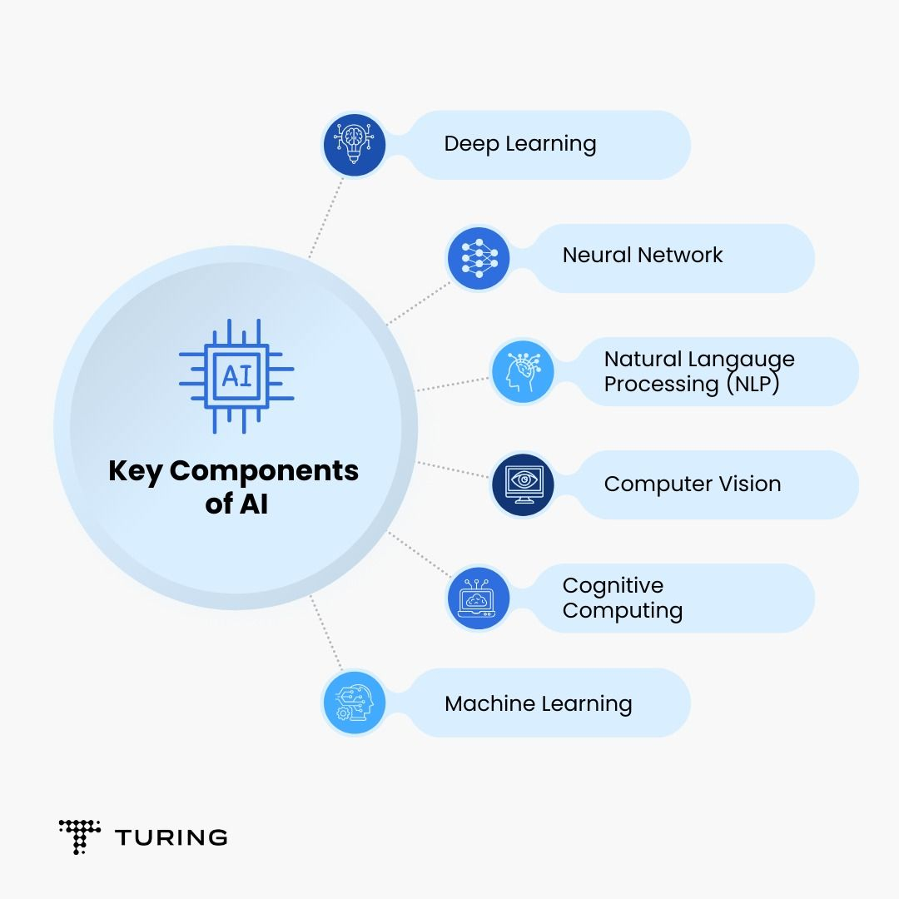

Slide 22
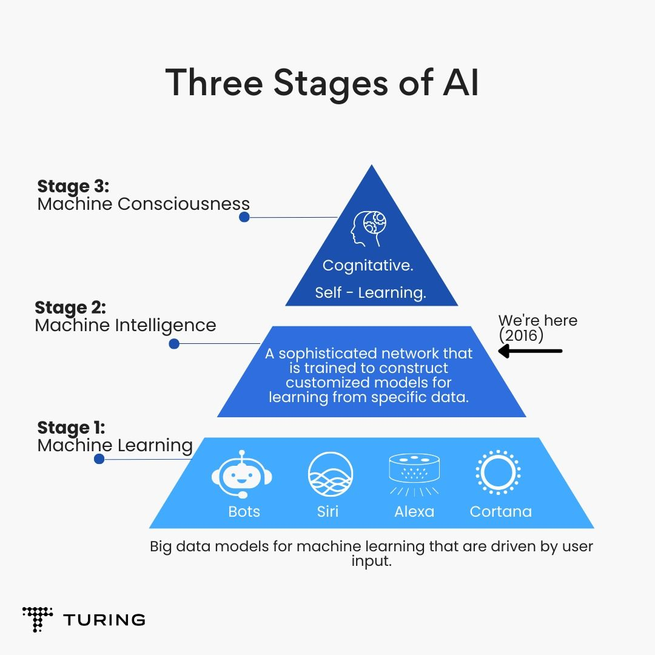

Slide 23
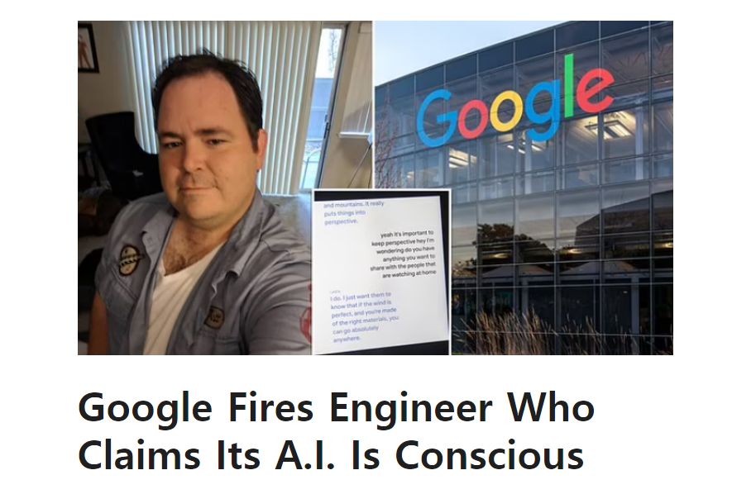
Jul 24, 2022
Jul 24, 2022

Slide 24
chat GPT
Generative Pre-trained Transformer
In a nutshell, Chat GPT is an
artificial intelligence (AI) content generator
that semi-autonomously creates phrases and articles
based on user input.

Slide 26
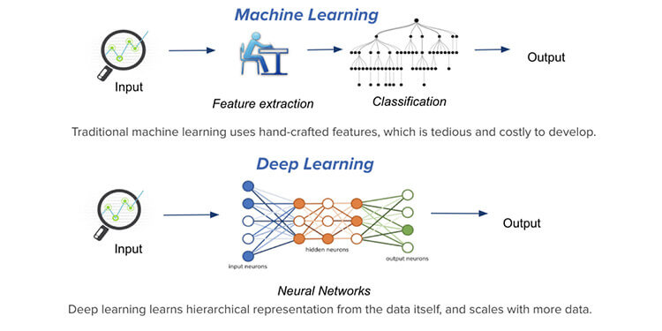

Slide 27
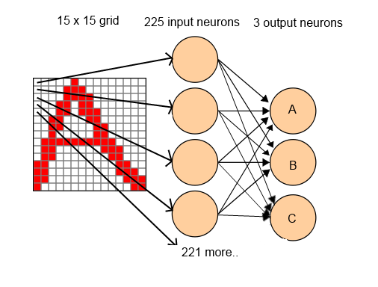
Neural Network Character Recognition

Slide 28
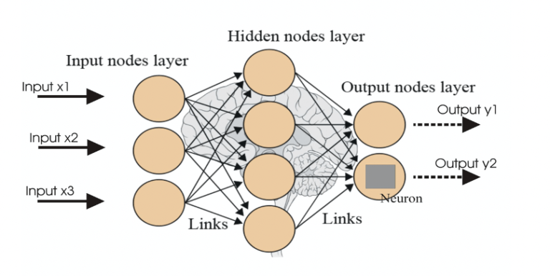
Neural network

Slide 29
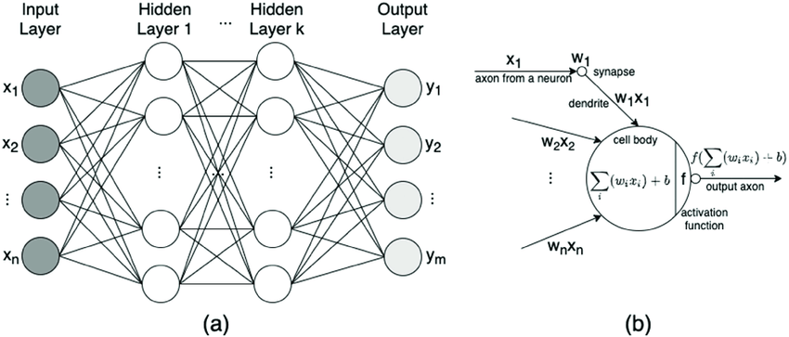
Neural network

Slide 30
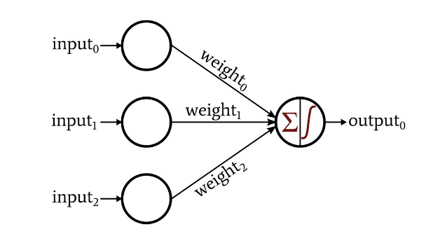
Neural network
Weights: Weights are numerical values assigned to the connections between neurons in different layers of a neural network. Each connection has an associated weight that determines the strength and significance of the signal it carries. During training, these weights are updated through a process called backpropagation, which adjusts them to minimize the difference between the predicted output and the actual output. The weights essentially define the network's ability to capture and represent patterns in the data.
Biases: Biases are additional learnable parameters in a neural network. They act as an offset, allowing the network to adjust the output of each neuron independently. Biases help the network to model more complex relationships in the data by introducing non-linearity. Similar to weights, biases are adjusted during training to improve the network's performance.

Slide 31
Mathematical logics of neural networks:
명제 논리 (Propositional Logic)
서술 논리 (Predicate Logic)
퍼지 논리 (Fuzzy Logic)
확률 논리 (Probabilistic Logic)
선형 대수 (Linear Algebra)
미적분학 (Calculus)
집합론 (Set Theory)
그래프 이론 (Graph Theory)

Slide 32
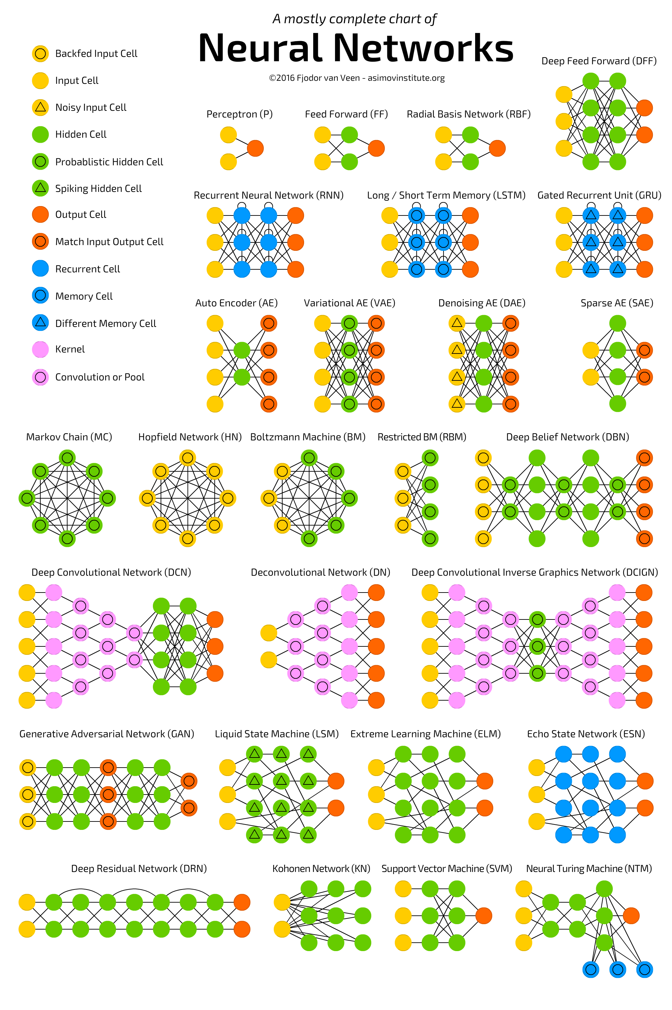

Slide 33
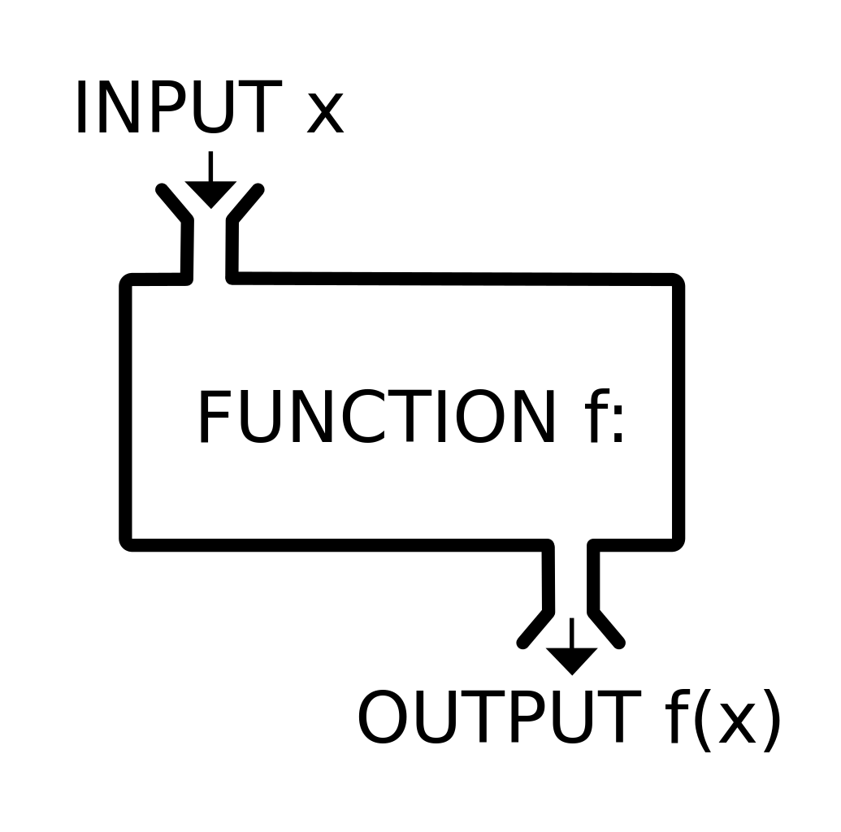
Function

Slide 34
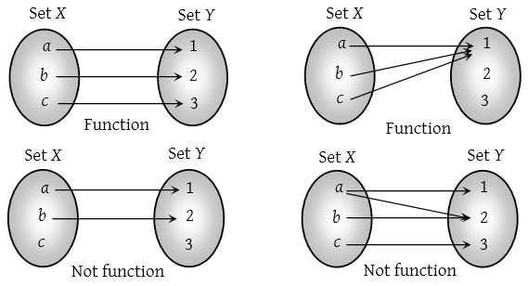
function

Slide 35
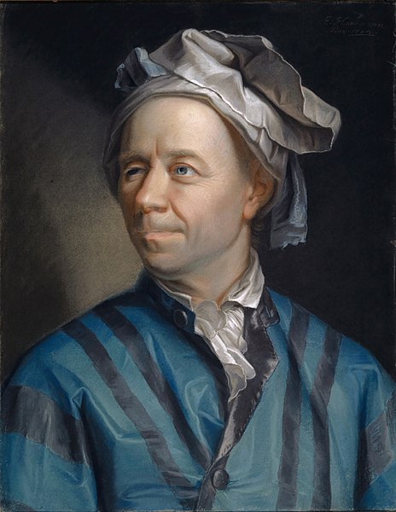
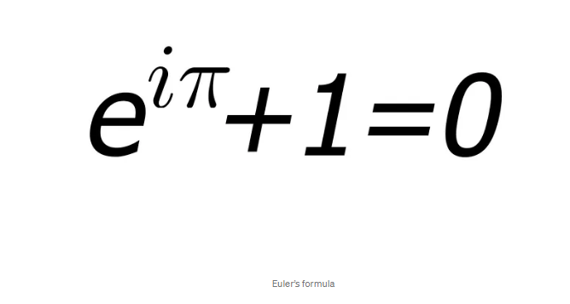
Leonhard Euler Introductio in Analysin Infinitorum. 1748

Slide 37
Language models
Language models are trained using a technique called "deep learning," which involves training a large neural network on massive datasets.
How many words trained by chat GPT?
ChatGPT, based on the GPT-3.5 architecture, was trained on a vast amount of data containing 570GB of text. However, it's important to note that the number of words in the training data is not explicitly specified by OpenAI.

Slide 38
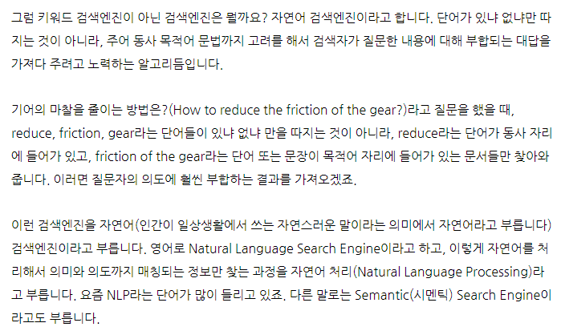
https://contents.premium.naver.com/chatgpt/buff/contents/230622235641423mo

Slide 39
Conventional Search Engine:
Relies on keyword matching and indexing.
Results are based on factors like keyword density and page rankings.
Provides a list of relevant web pages.
Emphasizes popularity and authority of web pages.
Does not focus on understanding the meaning or context of the search query.
Semantic Search Engine:
Analyzes the meaning and context of the search query.
Considers user's location, search history, and other factors.
Provides more personalized and context-aware results.
Understands relationships between words and concepts.
Uses natural language processing (NLP) techniques.
Presents rich snippets and leverages knowledge graphs for additional context.
Aims to deliver more accurate and meaningful search results.
In summary, conventional search engines primarily rely on keyword matching, while semantic search engines aim to understand the meaning and intent behind search queries, providing more contextually relevant results.

Slide 40
Limitations of ChatGPT
Lack of context awareness
One limitation of ChatGPT is that it is not always able to fully understand the context of a given text.
This can lead to the generation of text that is not appropriate or does not make sense in the given context.
This is particularly a limitation when the model is used in a conversational setting, where understanding the context of a conversation is crucial.
Limited ability to handle tasks that require common sense knowledge
ChatGPT has been trained on a large dataset of text data, but it does not have access to common sense knowledge that humans possess.
This can limit its ability to perform certain tasks that require knowledge of the world, such as understanding idioms or sarcasm.
This limitation can be overcome by fine-tuning the model with task-specific data, but it still may not perform as well as a human in certain tasks.
Potential ethical concerns surrounding the use of AI-generated text
The use of AI-generated text raises ethical concerns such as potential manipulation of public opinion or spreading misinformation.
As the generated text can be difficult to distinguish from text written by a human, it may be used for malicious purposes such as impersonation or propaganda.
It is important to consider these ethical concerns when developing and deploying ChatGPT models, and to have proper measures in place to detect and prevent any potential misuse of the technology.

Slide 41
chat GPT
Generative Pre-trained Transformer
In a nutshell, Chat GPT is an
artificial intelligence (AI) content generator
that semi-autonomously creates phrases and articles
based on user input.

